Slide 1

Smart Nozzle Travel Optimization
MEEG 56303 - Additive Manufacturing
Team Members: Salman Mahmud Prottoy, Youwen Liang, Mehedi Hasan
5 May 2025

Slide 2
Presentation Outline
Introduction
Problem Statement
Design
Implementation
Testing
Findings
Future Works
Conclusion

Slide 3
Introduction : Enhancing Path Efficiency in Additive Manufacturing
Additive Manufacturing (AM), or 3D printing, enables complex structure fabrication via layer-by-layer deposition.
Fused Deposition Modelling (FDM) suffers from inefficient non-extrusion movements (e.g., travel paths), increasing:
Total printing time
Energy consumption
Mechanical wear

Slide 4
Problem Statement
Traditional slicers use fixed geometric strategies without optimizing the travel path.
Leads to:
Redundant motions (e.g., backtracking, sharp turns)
Poor energy efficiency
Suboptimal printing speed

Slide 5
Research Objectives
Model travel path optimization as a combinatorial problem, akin to the Travelling Salesman Problem (TSP).
Propose an improved greedy algorithm with:
Dynamic priority adjustment based on real-time print segment distribution
A 2-Opt local‐search which iteratively swaps any two segments if it reduces total travel distance.

Slide 6
Design : Model Selection & G-code Generation
Used built-in and online 3D models
G-code generated using two slicers:
PrusaSlicer
BambuStudio
Compared pre and post-optimization print times.

Slide 7
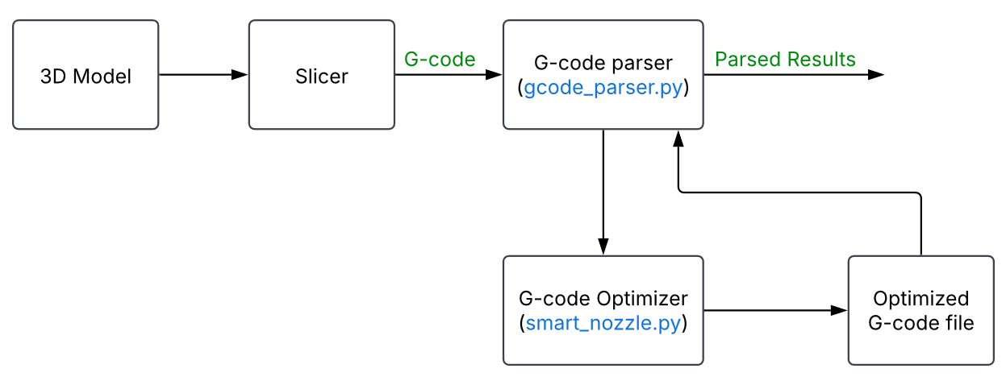
Design
Core Modules:
gcode_parser.py: Handles file parsing & statistics
smart_nozzle.py: Implements 2-Opt TSP-based path optimization
Figure 01: Workflow design diagram

Slide 8
Design
split_file():
Identifies layer boundaries via Z-move regex
Separates header, layer blocks, and footer
parse_stats():
Distinguishes extrusion vs. travel moves
Tracks feed rate, distance, and XY motion
Generates a summary Data Frame of print metrics

Slide 9
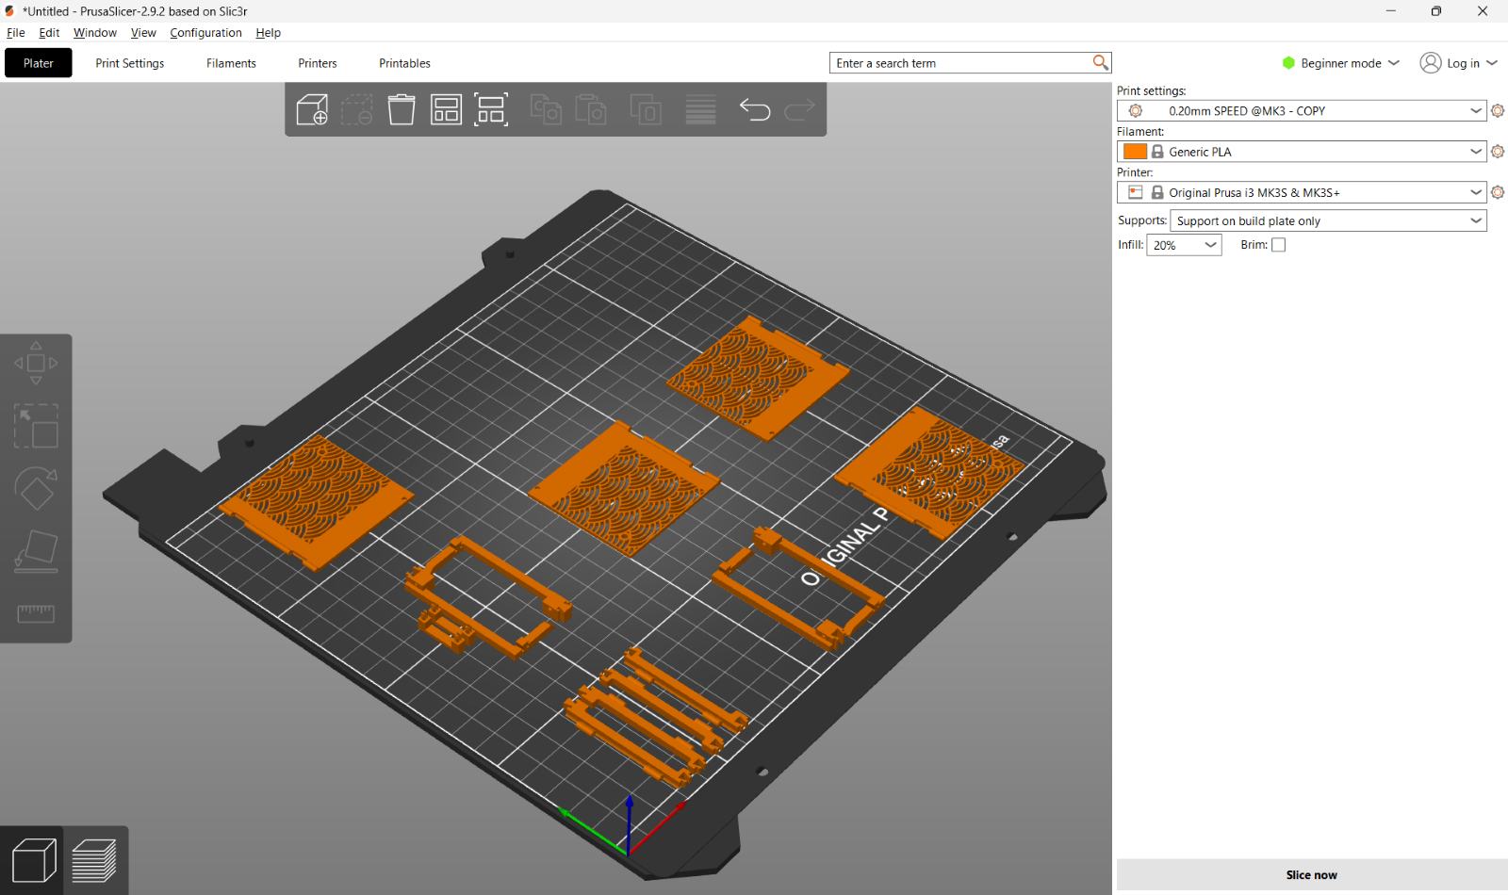
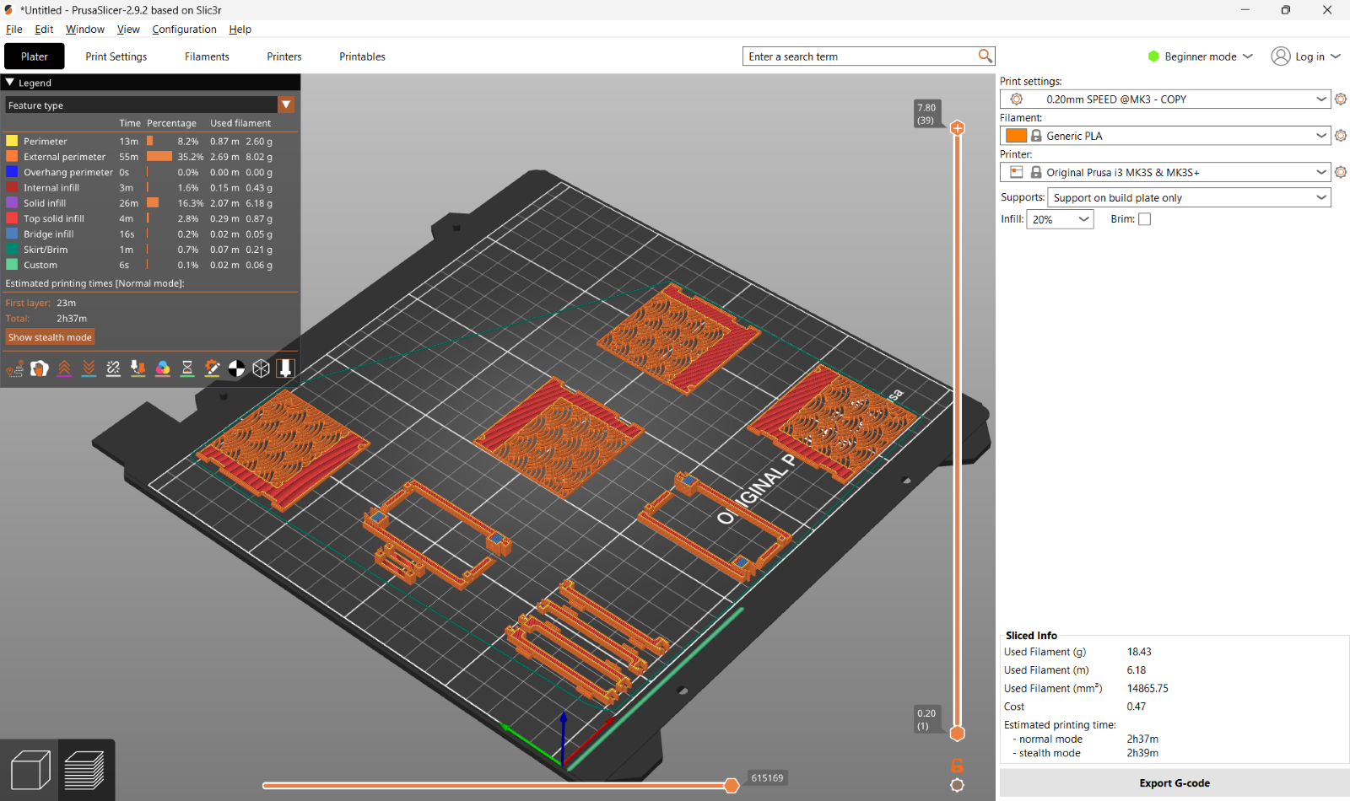
Implementation
Load 3D model in PrusaSlicer 2.9.2
Sliced the model and export G-code

Slide 10
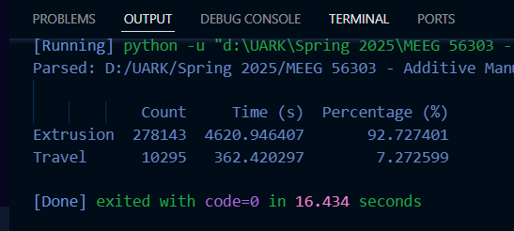
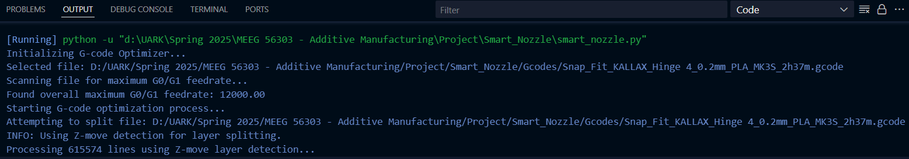
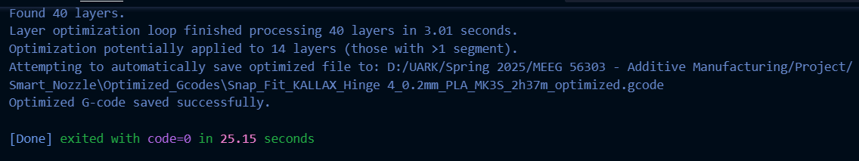
Implementation
Extract data from gcode_parser.py
Optimize and output new G-code by running smart_nozzle.py

Slide 11
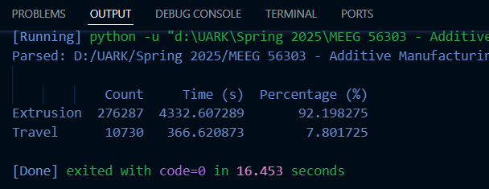
Implementation
Parse and compare the optimized results to original results

Slide 12
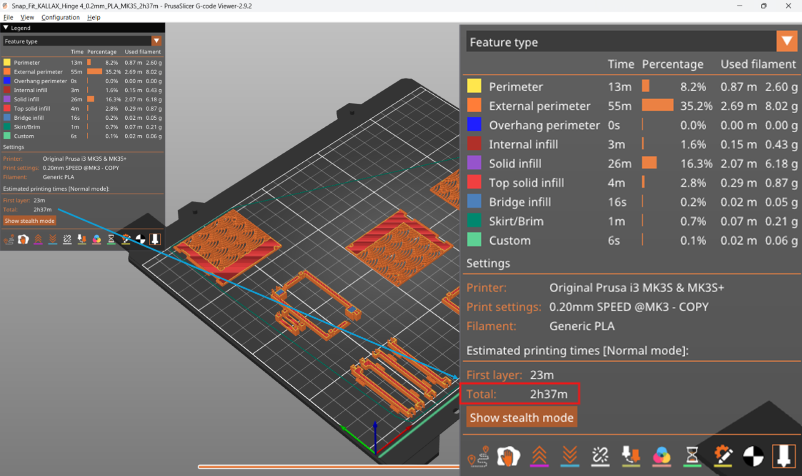
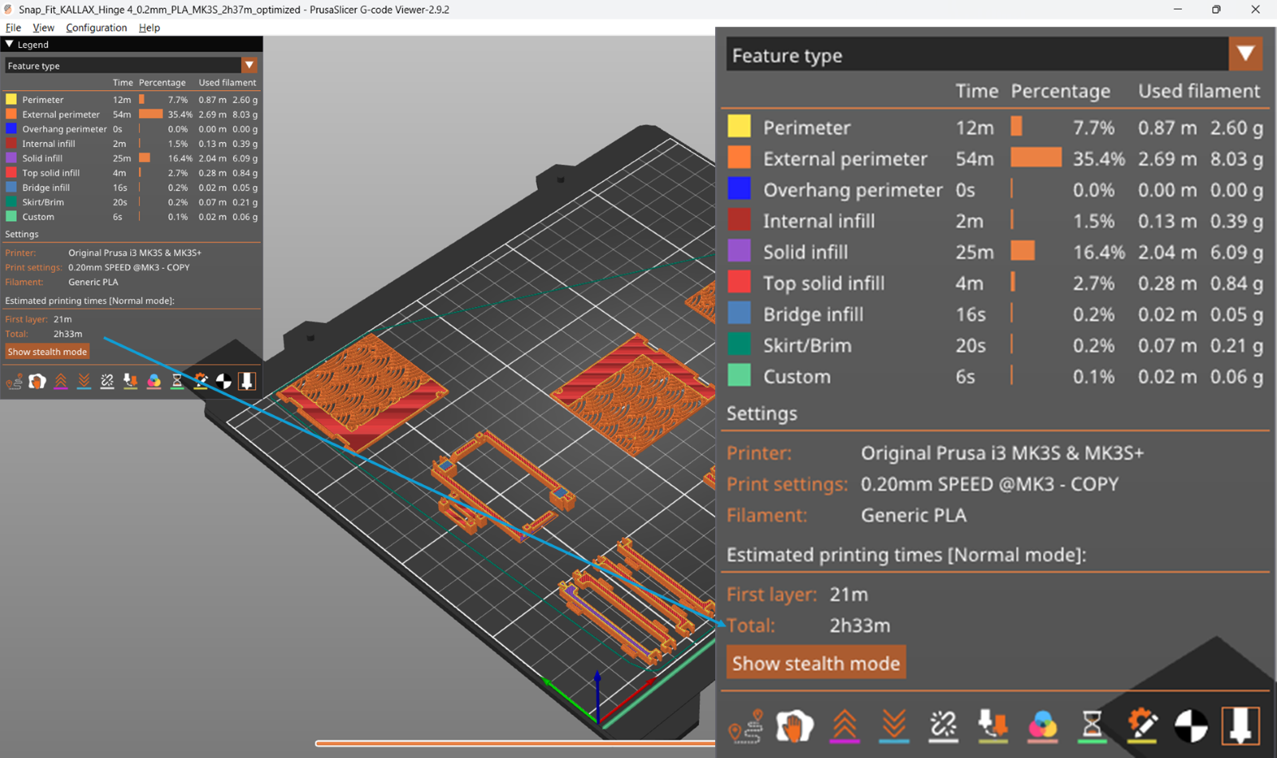
Implementation
Load the original G-code and optimized G-code in PrusaSlicer
Original G-code
Optimized G-code

Slide 13
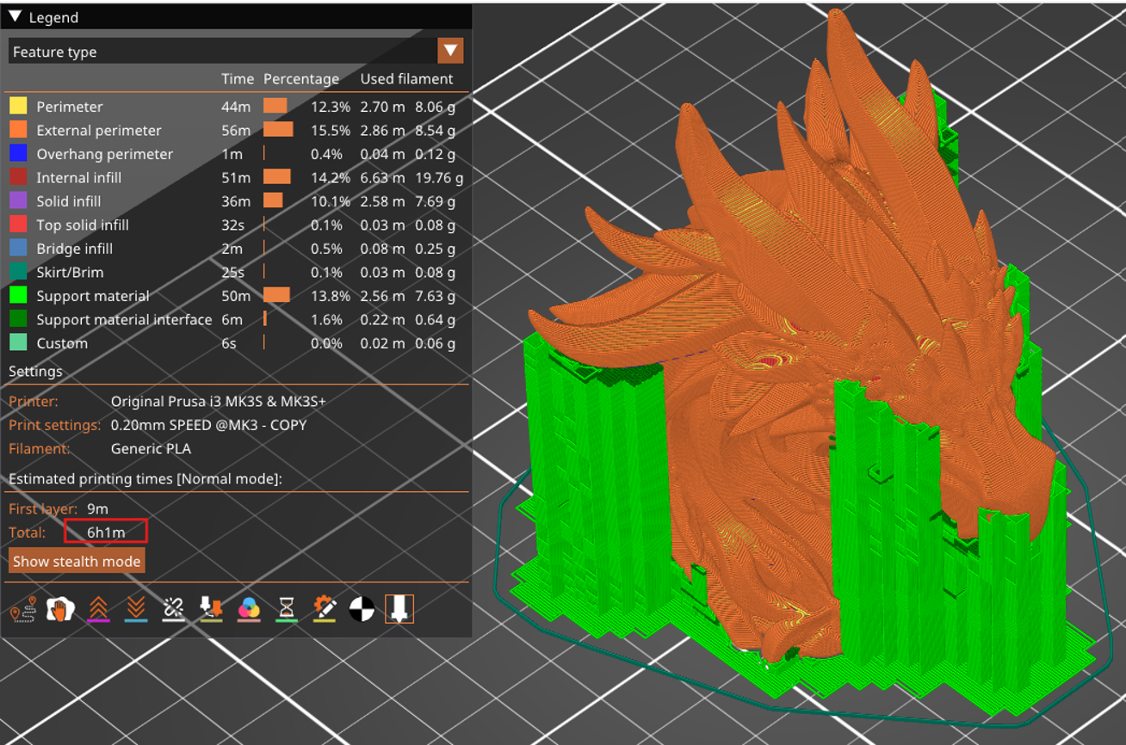
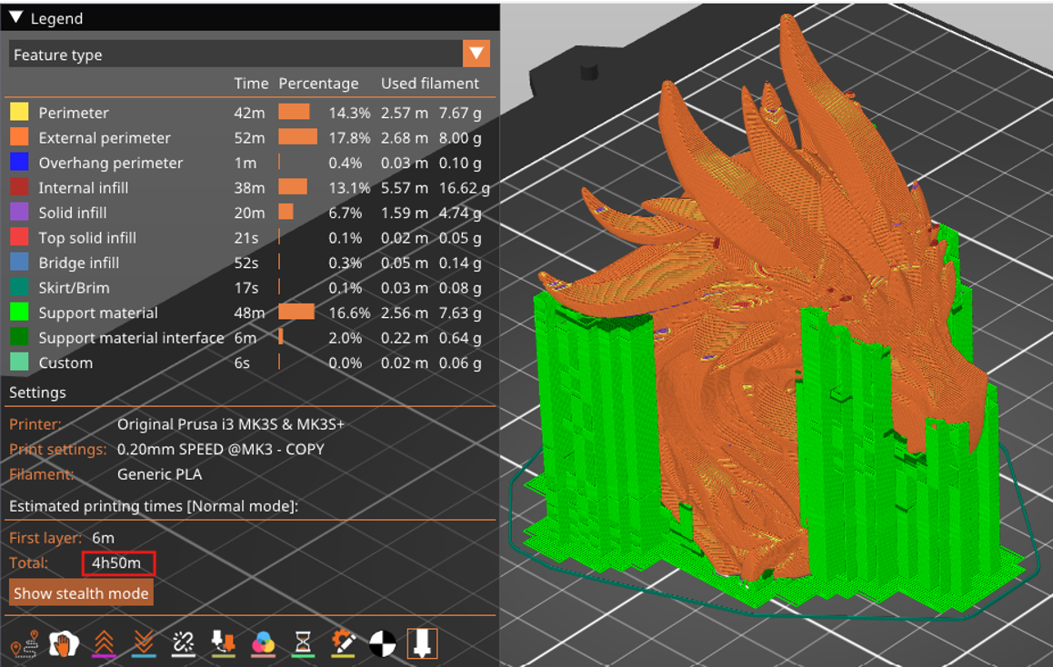
Testing
Before Optimization | After Optimization

Slide 14
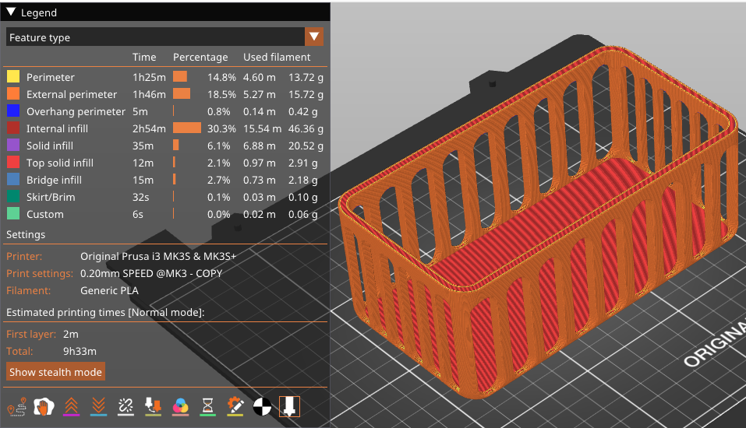
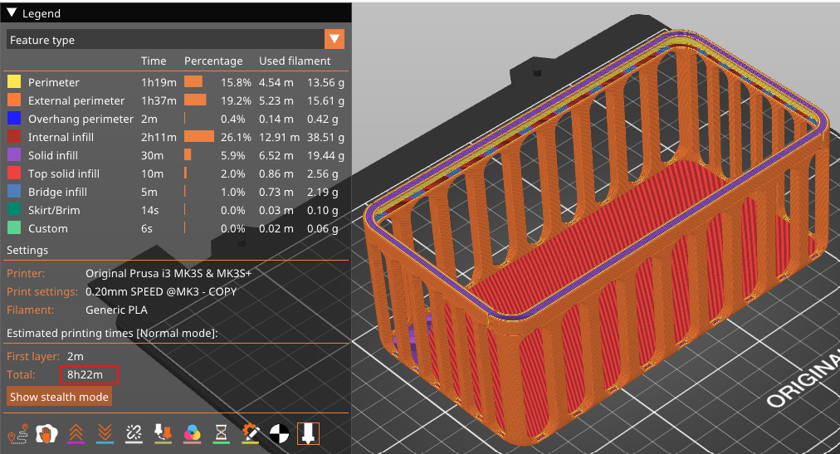
Testing
Before Optimization | After Optimization

Slide 15
Future Work
Current Limitation:
Does not include global route optimization
Longer run-time
May be less effective for high-complexity geometries
Future Direction:
Integrate global optimization methods (e.g., TSP solvers, hybrid heuristics)
Aim to enhance scalability and efficiency

Slide 16
Conclusion
Greedy Algorithm Efficiency:
Two-stage optimization significantly reduces printing time
Demonstrated effectiveness across multiple model types
Low Computational Requirement:
Works on standard PCs or 3D printer control units
Ideal for real-time path planning in resource-constrained environments

Slide 17
Acknowledgements
Dr. Wenchao Zhou
PrusaSlicer's Printables Library
Salman
Youwen
Mehedi

Slide 18
References
[1] K.-Y. Fok, C.-T. Cheng, N. Ganganath, H. H.-C. Iu, and C. K. Tse, “Accelerating 3D Printing Process Using an Extended Ant Colony Optimization Algorithm,” in 2018 IEEE International Symposium on Circuits and Systems (ISCAS), May 2018, pp. 1–5. doi: 10.1109/ISCAS.2018.8351113.
[2] X. Lin, Z. Huang, W. Shi, and K. Guo, “A Novel Ant Colony Algorithm for Optimizing 3D Printing Paths,” Electronics, vol. 13, no. 16, Art. no. 16, Jan. 2024, doi: 10.3390/electronics13163252.
[3] P. Lechowicz, L. Koszalka, I. Pozniak-Koszalka, and A. Kasprzak, “Path optimization in 3D printer: Algorithms and experimentation system,” in 2016 4th International Symposium on Computational and Business Intelligence (ISCBI), Sep. 2016, pp. 137–142. doi: 10.1109/ISCBI.2016.7743272.
[4] Z. Ma, W. Wan, L. Song, C. Liu, H. Liu, and Y. Wu, “An Approach of Path Optimization Algorithm for 3D Concrete Printing Based on Graph Theory,” Applied Sciences, vol. 12, no. 22, Art. no. 22, Jan. 2022, doi: 10.3390/app122211315.
[5] K.-Y. Fok, N. Ganganath, C.-T. Cheng, H. H.-C. Iu, and C. K. Tse, “A Nozzle Path Planner for 3-D Printing Applications,” IEEE Transactions on Industrial Informatics, vol. 16, no. 10, pp. 6313–6323, Oct. 2020, doi: 10.1109/TII.2019.2962241.
[6] K.-Y. Fok, C.-T. Cheng, and C. K. Tse, “A refinement process for nozzle path planning in 3D printing,” in 2017 IEEE International Symposium on Circuits and Systems (ISCAS), May 2017, pp. 1–4. doi: 10.1109/ISCAS.2017.8050471.

Slide 19
Any Questions? ----- Thank You

